Slide 1
HOUSING: PRICE PREDICTION
Houses are one of the necessary need of each and every person around the globe and therefore housing and real estate market is one of the markets which is one of the major contributors in the world’s economy. It is a very large market and there are various companies working in the domain. Data science comes as a very important tool to solve problems in the domain to help the companies increase their overall revenue, profits, improving their marketing strategies and focusing on changing trends in house sales and purchases. Predictive modelling, Market mix modelling, recommendation systems are some of the machine learning techniques used for achieving the business goals for housing companies. Our problem is related to one such housing company.

Slide 2
Problem Statement:
A US-based housing company named Surprise Housing has decided to enter the Australian market.
The company uses data analytics to purchase houses at a price below their actual values and flip them at a higher price. For the same purpose, the company has collected a data set from the sale of houses in Australia.
The data is provided in the CSV file.
The company is looking at prospective properties to buy houses to enter the market.
We are required to build a model using Machine Learning in order to predict the actual value of the prospective properties and decide whether to invest in them or not.
The company wants to know:
Which variables are important to predict the price of variable?
How do these variables describe the price of the house?

Slide 3
Understanding:
There are 2 excel sheets that have been shared.
First, excel sheet is the detailed data of the houses along with all the features and prices.
Second, excel sheet is the list of all the houses and we need to predict the prices of the houses.
There are information of houses which have certain features and build structures on which the price of the house might depend.
The features can be relevant or irrelevant for the pricing of house.
We need to find the relevance of the features in predicting the price of the house.

Slide 4
Business Goals:
We are required to model the price of houses with the available independent variables.
This model will then be used by the management to understand how exactly the prices vary with the variables. They can accordingly manipulate the strategy of the firm and concentrate on areas that will yield high returns.
Further, the model will be a good way for the management to understand the pricing dynamics of a new market

Slide 5
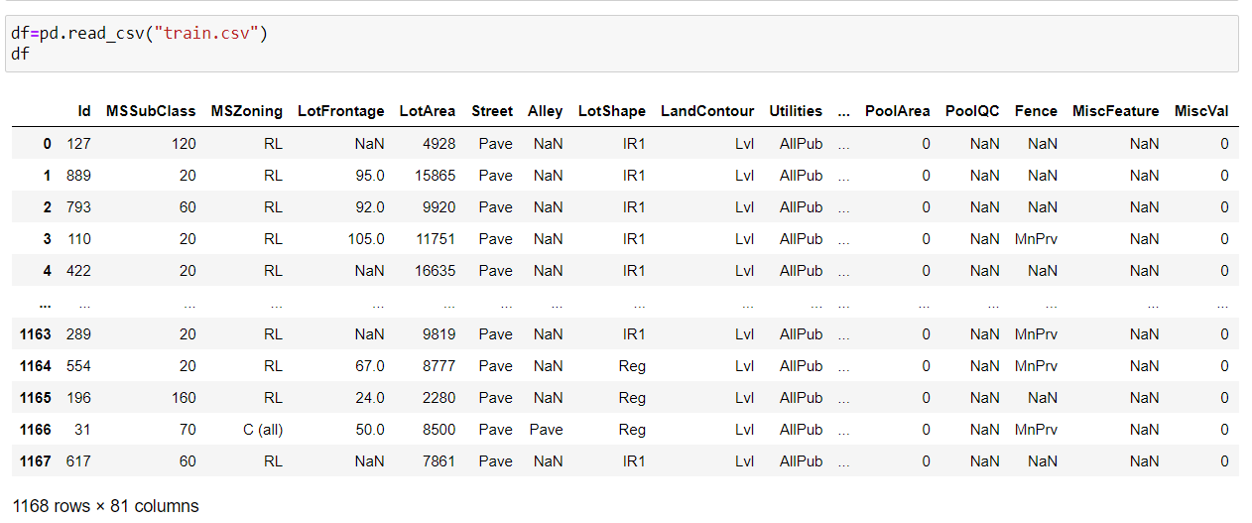
First Dataset:

Slide 6
EDA:
Shape of first dataset is 1168, 81.
Information of dataset:
RangeIndex: 0 to 1167.
Data columns: 81.
dtypes: float64(3), int64(35), object(43).

Slide 7
Null Values:
LotFrontage
Alley
MasVnrType
MasVnrArea
BsmtQual
BsmtCond
BsmtExposure
BsmtFinType1
BsmtFinType2
FireplaceQu
GarageType
GarageYrBlt
GarageFinish
GarageQual
GarageCond
PoolQC
Fence
MiscFeature

Slide 8
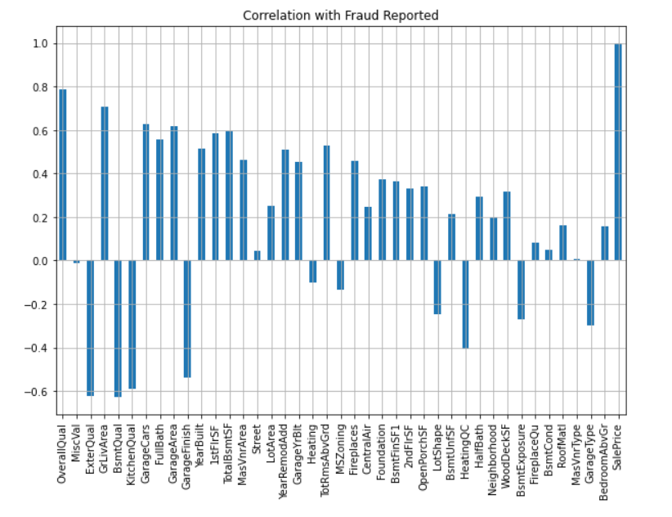
Top 40 Features:

Slide 9
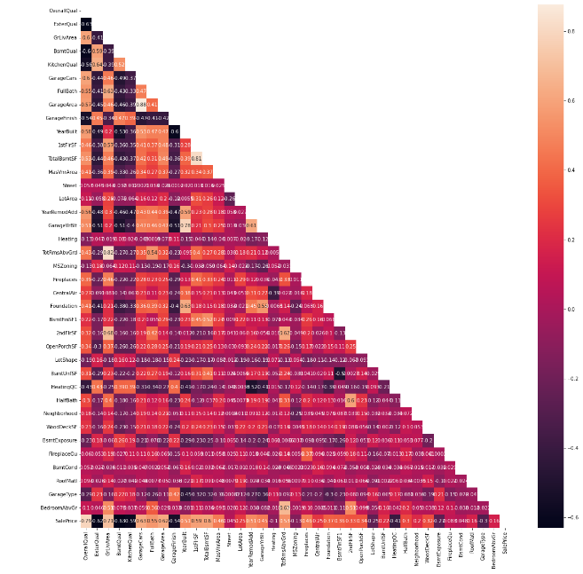
There are multicollinearity problem present in our dataset.
TotRmsAbvGrd & GrLivArea, has the correlation of 82%.
GarageArea & GarageCars, has the correlation of 88%.
TotalBsmtSF & 1stFlrSF, has the correlation of 81%.

Slide 10
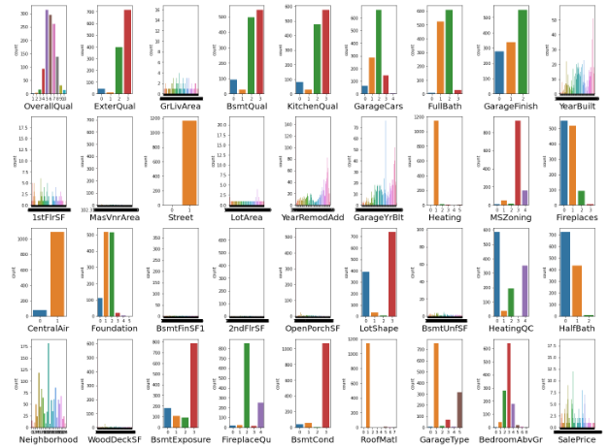
Visualisation:

Slide 11
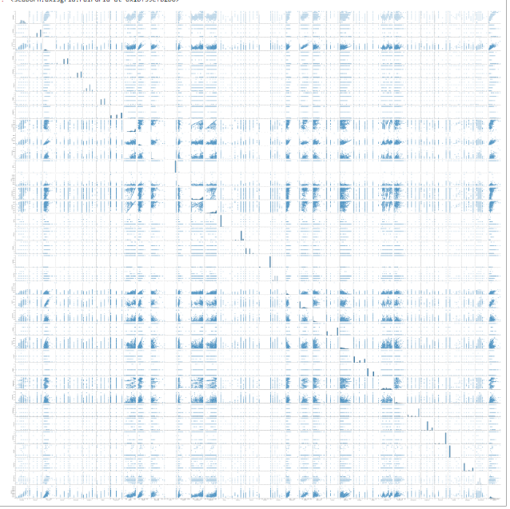
Pairplot:

Slide 12
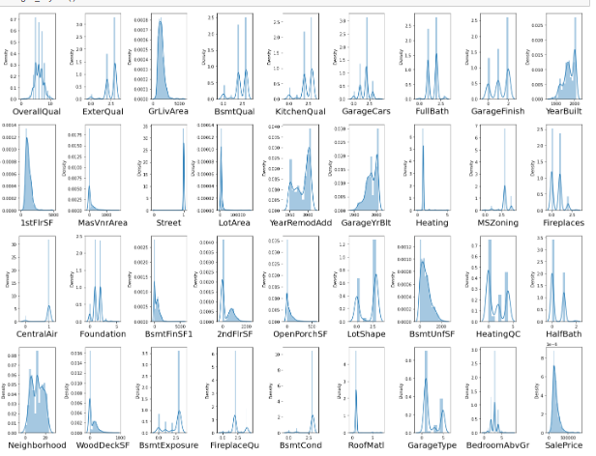
Normal Distribution:

Slide 13
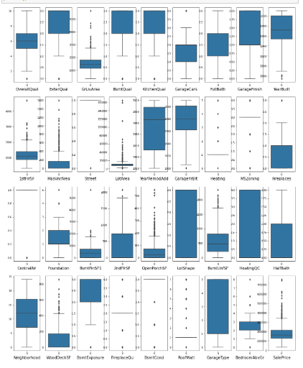
Outliers:

Slide 14
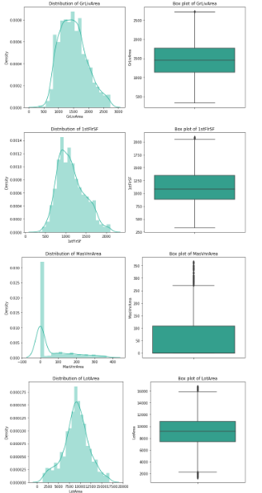
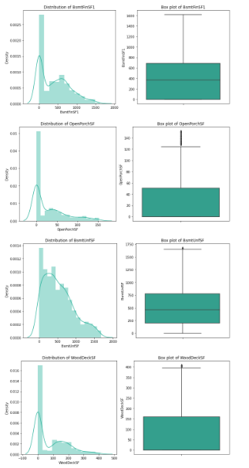
Removing Outliers:

Slide 15
Model Dashboard:
lr = LinearRegression()
rf = RandomForestRegressor()
ada = AdaBoostRegressor()
gb = GradientBoostingRegressor()
hgb = HistGradientBoostingRegressor()
knn = KNeighborsRegressor()

Slide 16
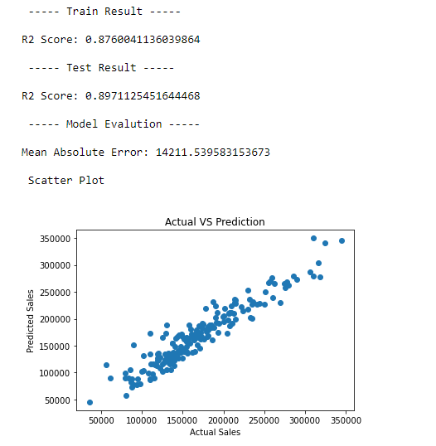
Linear Regression:

Slide 17
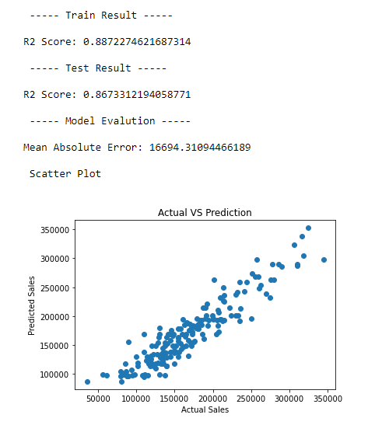
Adaboost Regressor:

Slide 18
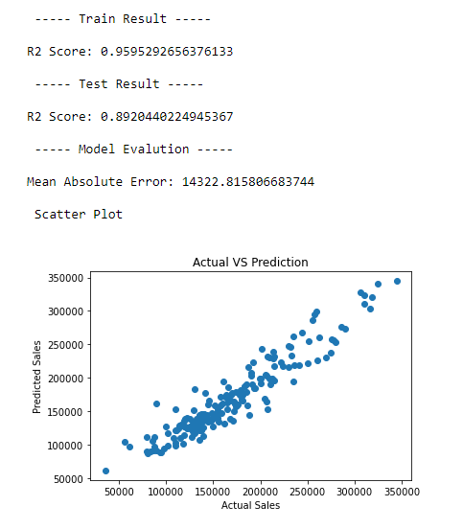
GradientBoosting Regressor:

Slide 19
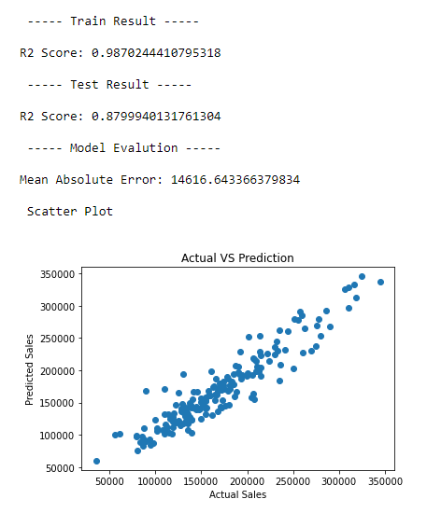
HistGradientBoosting Regressor:

Slide 20
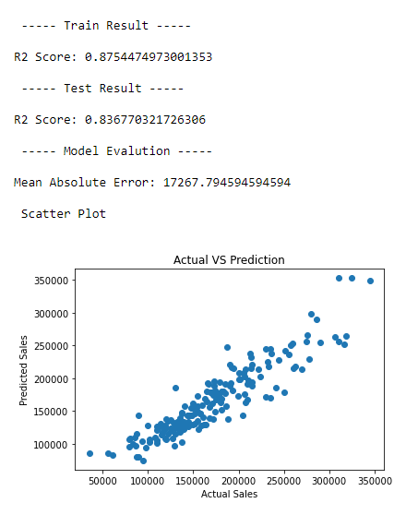
KNeighbors Regressor: Best Model, Parameters & Score: GradientBoosting Regressor

Slide 21
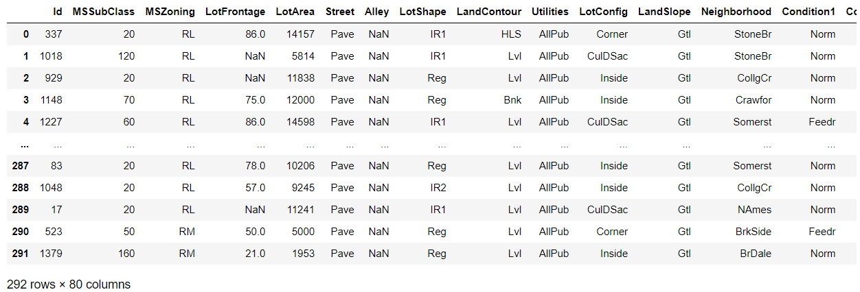
Test Dataset:

Slide 22
